Slide 1

Multivariate Normality Tests and Hierarchical CFA in R
Psych 740: Theory Building & Model Testing

Slide 2
Overview of Slides
Multivariate Normality Tests (slides 3 to 8)
Second-order (hierarchical) CFA models (slides 9 to 14)

Slide 3
The MVN package
The MVN package contains various multivariate normality tests. Remember that multivariate normality is an assumption of maximum likelihood estimation. As a result, the MVN package can be used to see if there are severe violations of this assumption. To install and load the package:
install.packages(“MVN”, dependencies = TRUE)
library(MVN)

Slide 4
The mvn function
You can use the mvn() function to estimate various multivariate normality tests. It tends to be most convenient to save the results of the mvn() function to an object name and then request certain output afterwards.

Slide 5
Examples
At a minimum, you want to supply the mvn() function a data file or a data frame with the variables/items you wish to test multivariate normality on, as well as the MVN test you wish to perform. The mvn() function contains five options (the hz test is the default if you don’t specify one).
result <- mvn(data, mvnTest = "mardia")
Mardia’s MVN Test
result <- mvn(data, mvnTest = “hz")
Henze-Zirkler’s MVN Test
result <- mvn(data, mvnTest = “royston")
Royston’s MVN Test
result <- mvn(data, mvnTest = “dh")
Doornik-Hansen’s MVN Test
result <- mvn(data, mvnTest = “energy")
E-statistic

Slide 6
Subsetting Data
You usually don’t want to supply the entire data file to the function, only specific variables or items.
Let’s use the survey.csv data file as an example. Say we have a model that includes the positive affect, negative affect, and life satisfaction items. In the survey data set, those items are in columns 24 to 48.
So our code could look like:
result <- mvn(survey[c(24:48)], mvnTest = "mardia")
*If your variables/items are not all adjacent in column numbers, you can supply multiple ranges:
result <- mvn(survey[c(24:48, 59:68)], mvnTest = "mardia")

Slide 7
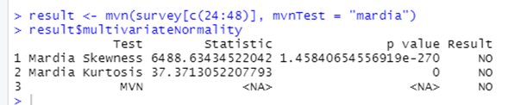
Multivariate Normality
To get the multivariate skewness and kurtosis estimates, use $multivariateNormality. The significance of these two estimates suggests whether multivariate normality is met or not.
result$multivariateNormality

Slide 8
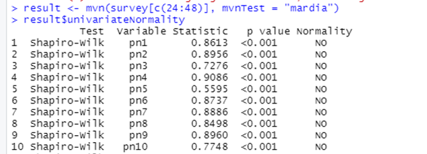
Univariate Normality
To get the univariate normality (Shapiro-Wilk) estimates, use $univariateNormality.
result$univariateNormality

Slide 9
Second-Order (Hierarchical) CFA
When you estimate a higher-level latent factor that has other latent factors as its indicators. Here is an example using the survey.csv data set:
*The indicators of the three sub-factors are not shown for illustration purposes
Well-Being
Life Satisfaction
Self-Esteem
Optimism

Slide 10
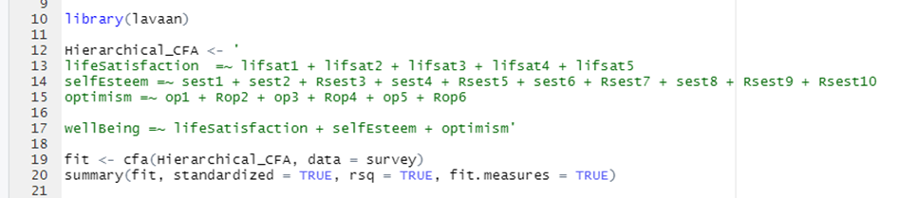
Example Model Syntax
The sub-factors would be estimated as usual. The only addition is the creation of the second-order latent factor which has the sub-latent factors as its indicators. As a default, lavaan will fix the first loading to 1 to set the scale of the second-order factor.

Slide 11
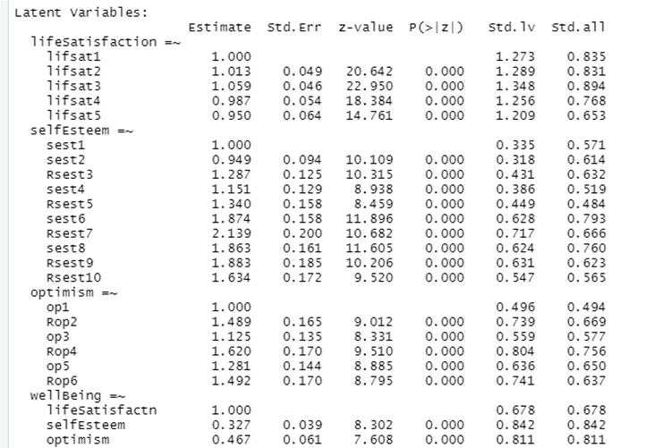
Relevant Output
Towards the bottom, you can see the loadings of the sub-factors on the second-order factor

Slide 12
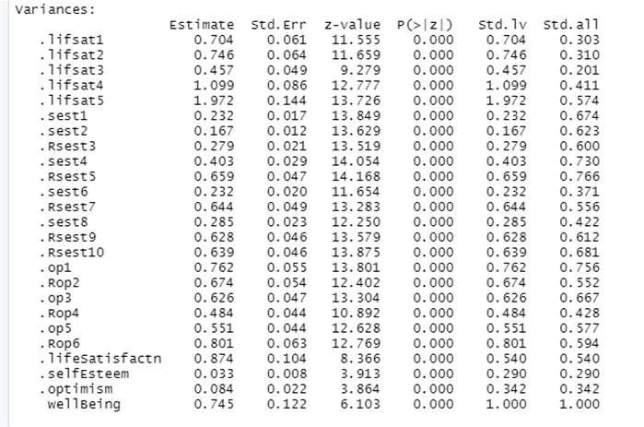
Relevant Output
Towards the bottom, you can see the residual variances for the sub-factors and the (exogenous) variance of the second-order factor

Slide 13
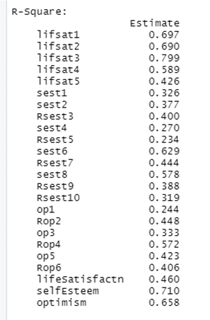
Relevant Output
The amount of variance in the sub-factors explained by the second-order latent factor

Slide 14
SEM Extensions
If you wish to put your second-order CFA into a larger SEM, all you would need to do is add direct effects from the second-order latent factor (e.g., well-being) to other constructs. Or, if the second-order factor is being predicted by some other construct, you would just regress the second-order factor onto other construct(s)

